Slide 1
QuizzMe! - Quiz Taking Platform
Ashwin S Nambiar
Date: 30 October 2024

Slide 2
INTRODUCTION
The QuizzMe! application is an interactive web-based platform designed to engage users in trivia quizzes across various topics.
Built using React, the application allows users to customize their quiz experience by selecting options such as category, difficulty, question type and number of questions.
It retrieves questions from the Open Trivia Database API, providing a dynamic and varied quiz experience.
Users can select their answers, receive immediate feedback, and enjoy celebratory animations upon achieving perfect scores.
The application features a responsive design that adapts to different screen sizes, ensuring accessibility across devices.

Slide 3
PROJECT OVERVIEW
The website aims to create a user-friendly, interactive quiz application that provides an engaging and enjoyable experience for the users .
The core objectives are to deliver a dynamic interface where users can easily select quiz categories, attempt questions, receive immediate feedback, and view their final scores.
The application is designed to be easily expandable, allowing the addition of new quiz categories and questions, making it a versatile platform for both casual and dedicated users interested in knowledge-based games.
There is a theme switching toggle for user convenience.
As well as smooth animations and transitions for better user experience also.

Slide 4
TECHNOLOGY STACK
HTML5
CSS3
JavaScript
React
Vite
HTML-entities
Nano ID
Open Trivia Database API

Slide 5
KEY FEATURES
Dynamic Quiz Generation:
The app dynamically fetches quiz questions from the Open Trivia Database API, allowing users to access a wide variety of questions without needing to hard-code them into the app.
Users can customize their quiz by selecting options such as category, difficulty, question type, and the number of questions.
Real-Time Question Interaction:
Answer Selection and Validation: Users can select answers to each question, which are visually highlighted to indicate their choice.
Upon completion, users can check their answers, revealing correct and incorrect responses with visual feedback such as icons or color changes, enhancing user engagement and learning.
Responsive Design :
The app includes responsive styles, adapting seamlessly across different devices and screen sizes, which allows users to enjoy the app on desktops, tablets, and smartphones without layout issues.
Questions are animated with incremental delays based on their order, providing a smooth and engaging transition effect on various screen sizes.

Slide 6
KEY FEATURES
Error Handling and Edge Case Management:
If the selected options yield no questions from the API, the app gracefully handles this by notifying the user and allowing them to adjust their settings.
The ”Check Answers” button remains disabled until all questions have an answer selected, preventing incomplete submissions and improving the user experience.
State Management and Modularity:
The app uses React’s useState and useEffect hooks to manage user interactions, question data, and animations efficiently, ensuring a smooth user experience.
The app is structured with reusable components (Question, QuestionList, etc.), each responsible for specific parts of the UI and logic, resulting in better code organization, readability, and easier maintenance.
Stylized User Interface:
The app includes unique button states and icons to distinguish selected, correct, and incorrect answers, providing intuitive visual cues.
Buttons and score displays are styled to give a polished feel to the app, making the quiz experience more interactive and visually appealing.

Slide 7
LANDING PAGE
The landing page of this website consists of mainly, a form container which has several options to choose. There is also a theme toggler present in top-right corner.
These include:
Category: choose the question category.
Difficulty: choose the difficulty level of questions.
Type: choose from True or False or MCQ questions.
No. of Questions: choose the number of questions users wish to face.
If no options are selected and all of them are at their default value then the questions will be a mixture of several categories, types and difficulties. Also the default value for number of questions is 1.
On clicking the “Start Quiz” button an API call will be made to Open Trivia DB and the questions will be sourced based on the values for the options the user has provided.
And then the questions will be rendered on the screen.
Next few slides will show the different aspects of the landing page.

Slide 8
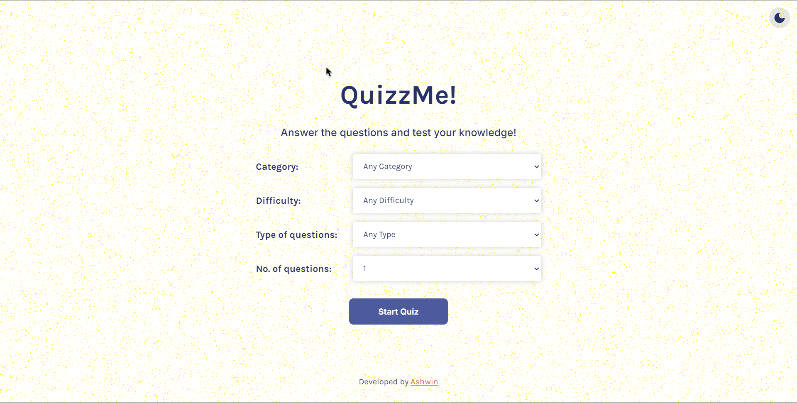
LANDING PAGE

Slide 9
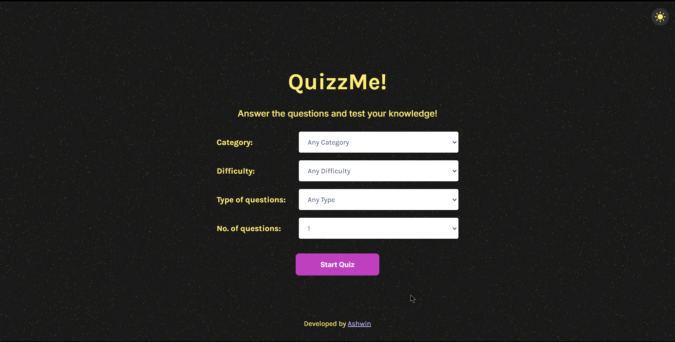
LANDING PAGE - DARK MODE

Slide 10
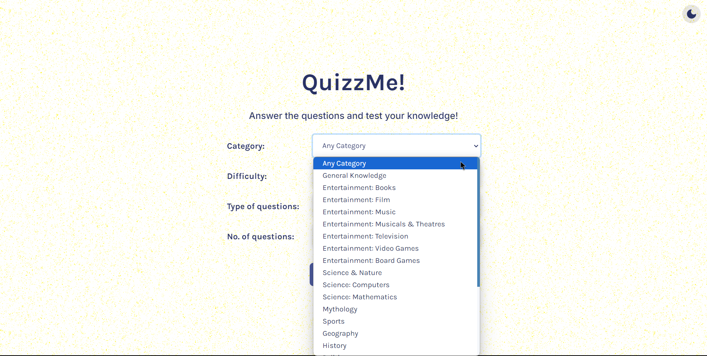
QUESTION CUSTOMIZATION - 1

Slide 11
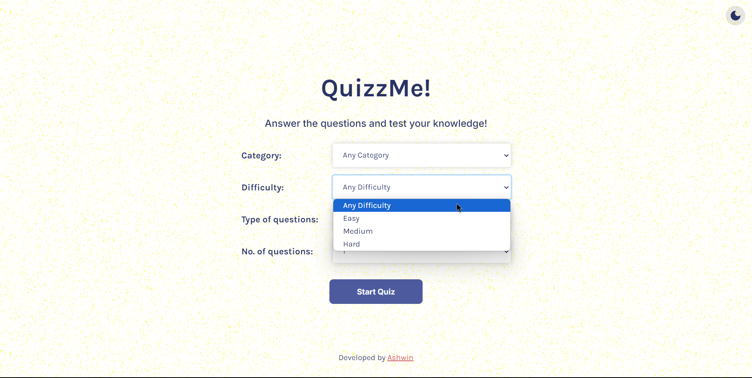
QUESTION CUSTOMIZATION - 2

Slide 12
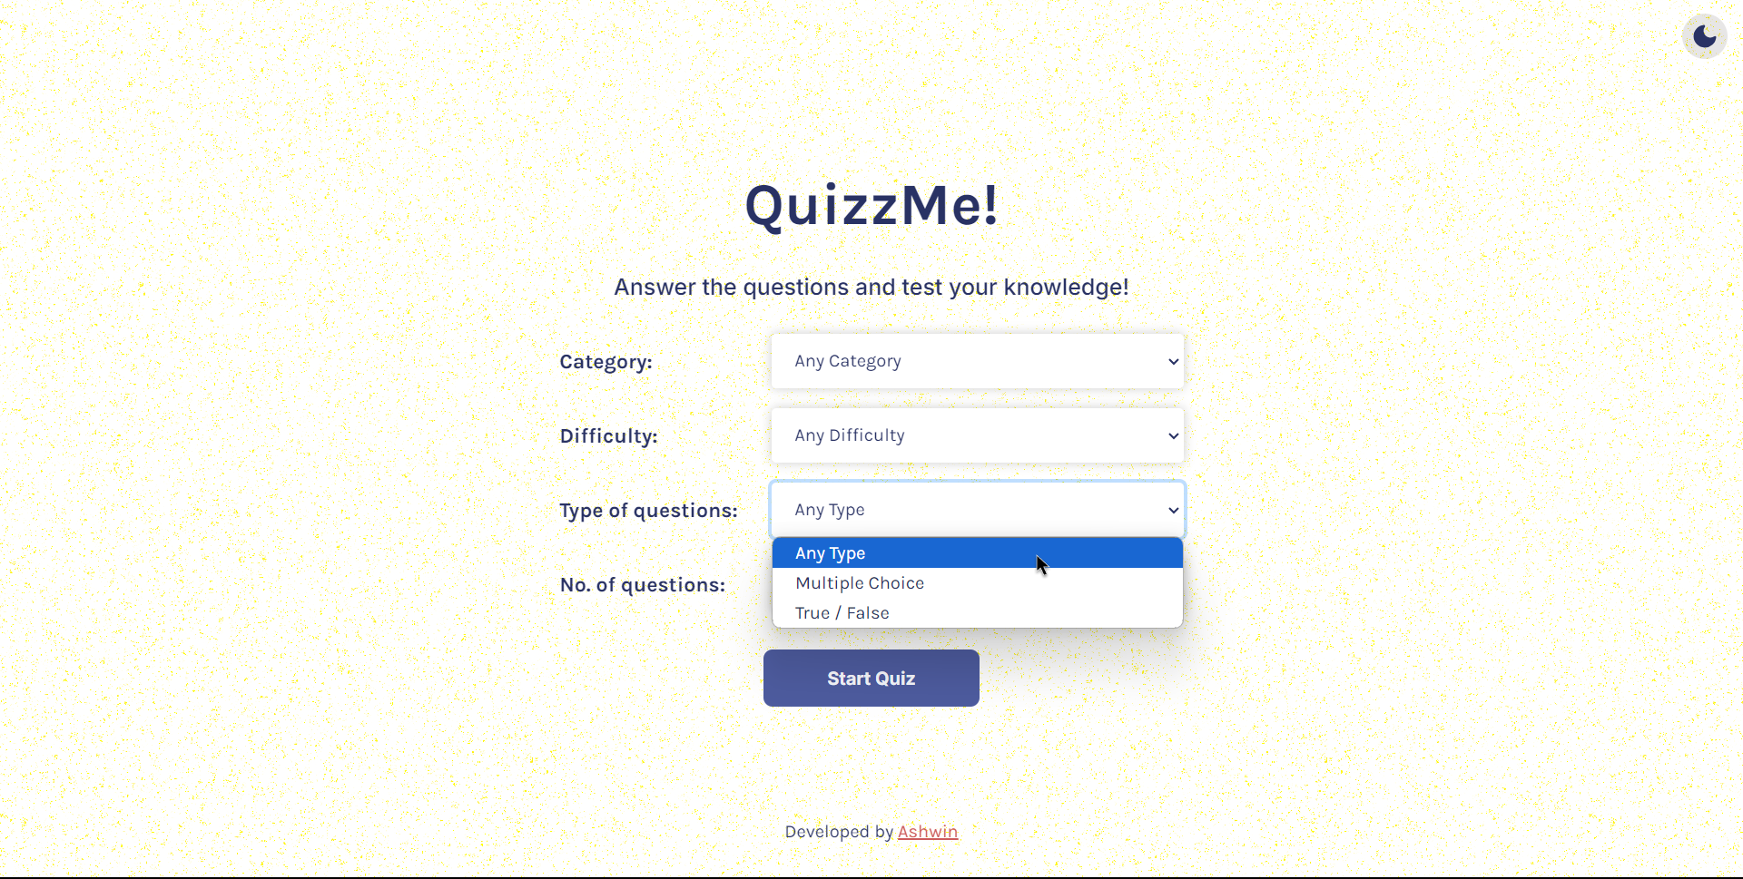
QUESTION CUSTOMIZATION - 3

Slide 13
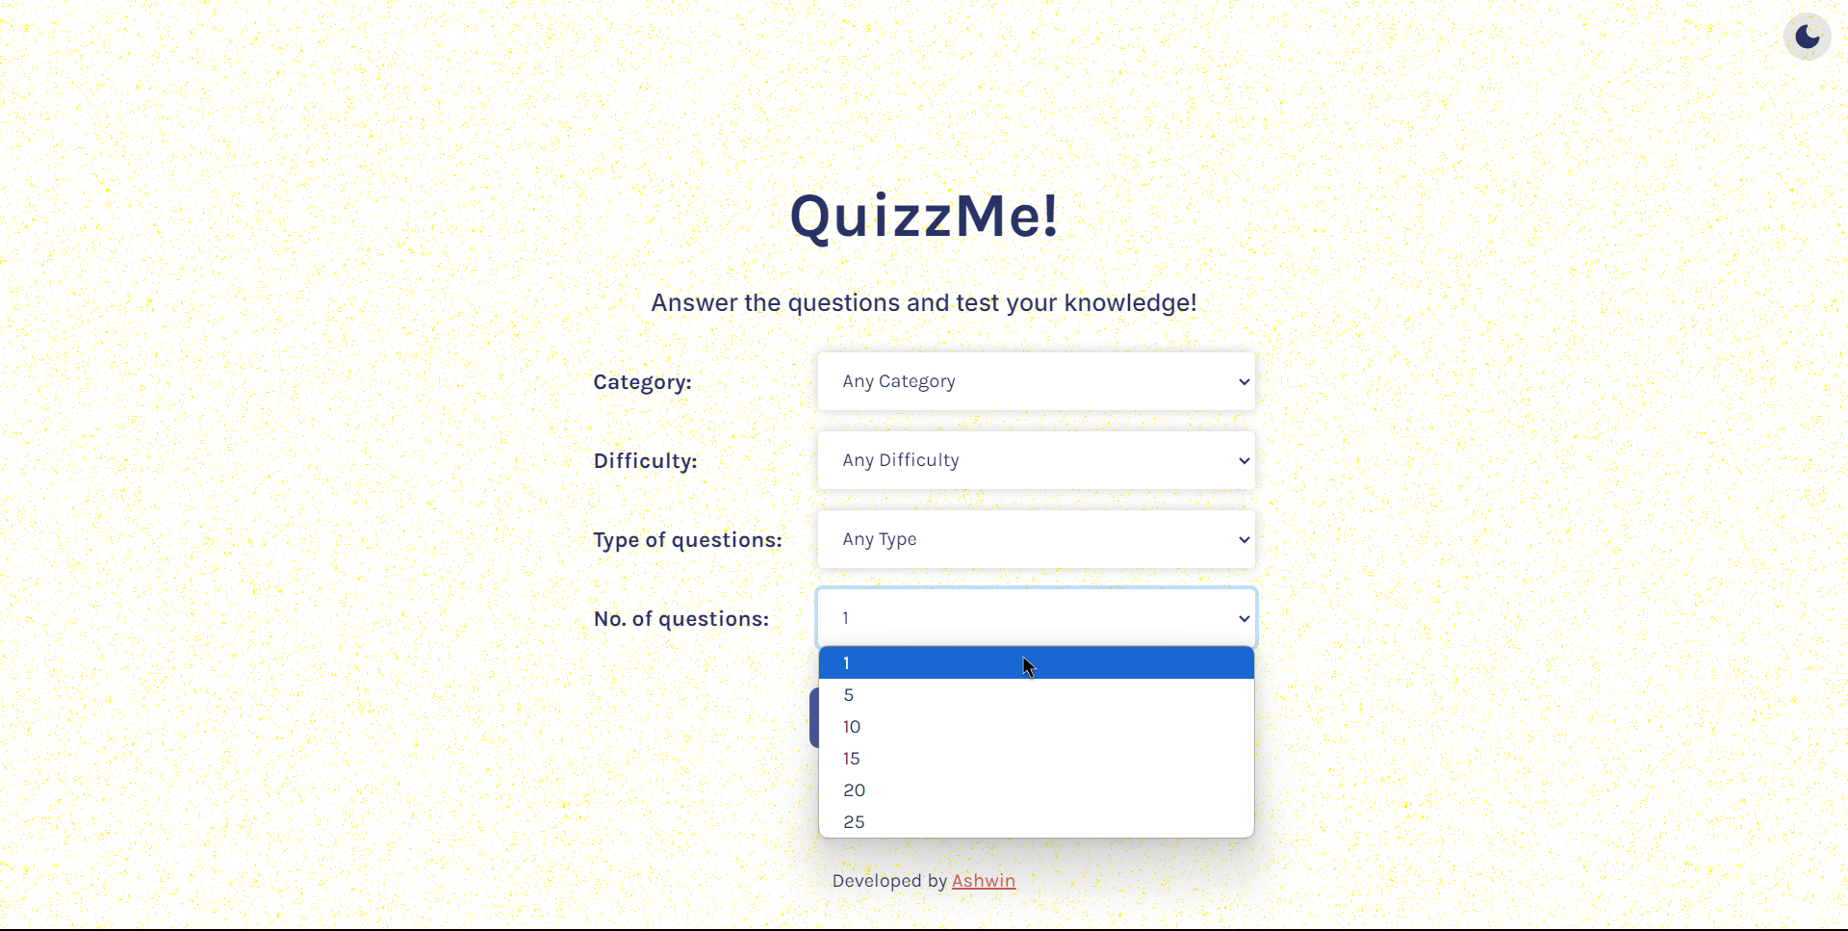
QUESTION CUSTOMIZATION - 4

Slide 14
QUESTIONS PAGE
The questions page also has a similar layout with the landing page including the theme toggler.
The page also displays the questions that are rendered which uses the data received from the API call to render the question component.
User is able to select an answer for each question and only after the user selects answers for all the questions the “Check answers” button is enabled.
On clicking the “Check answers” button the score that the user has scored is revealed and a “Play again” button is shown if the user wants to play again.
If an user is able to get all of the answers correct then a confetti animation is shown in the screen.
On clicking “Play again”, the user is redirected back to the landing page where he can make any changes to the question customization and start the quiz again.
Next few slides will show in detail the various aspects of the questions page.

Slide 15
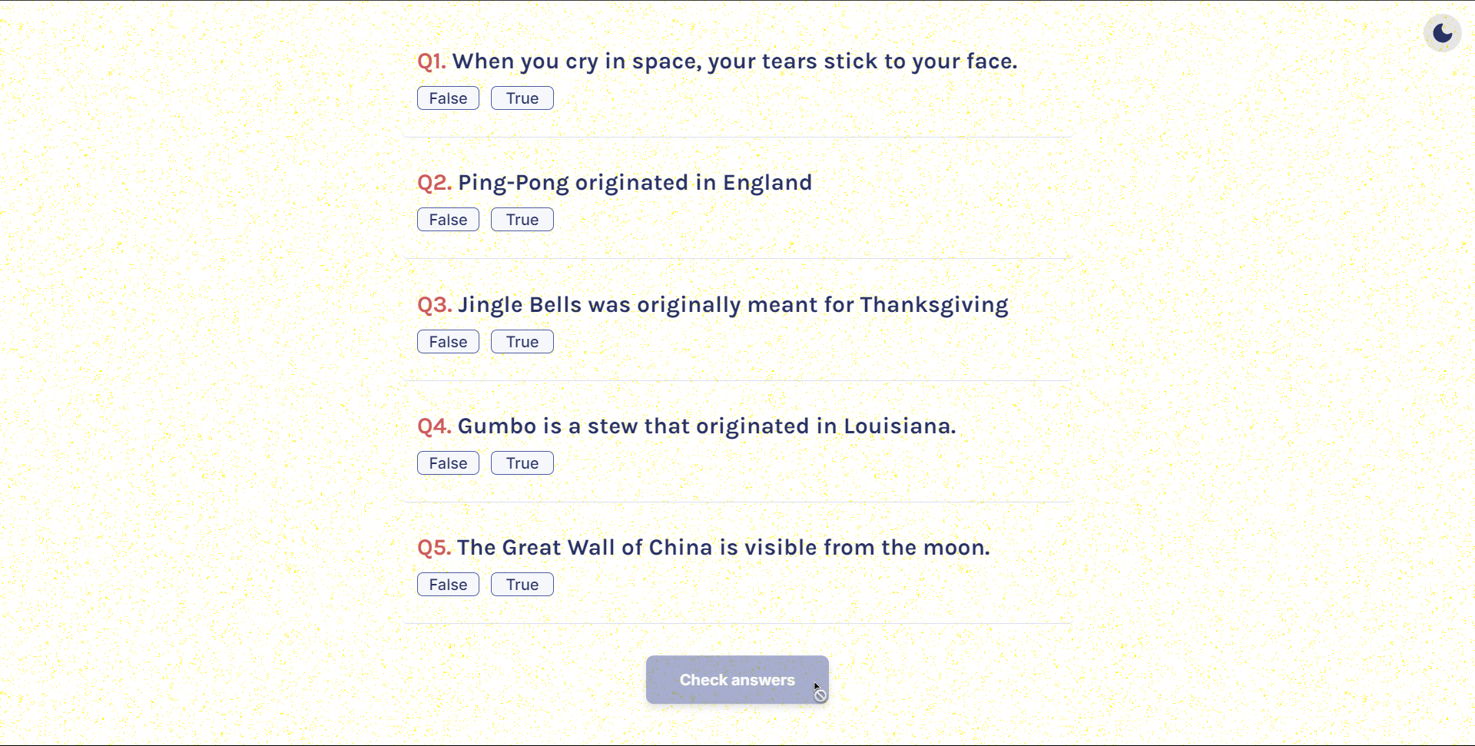
QUESTIONS PAGE

Slide 16
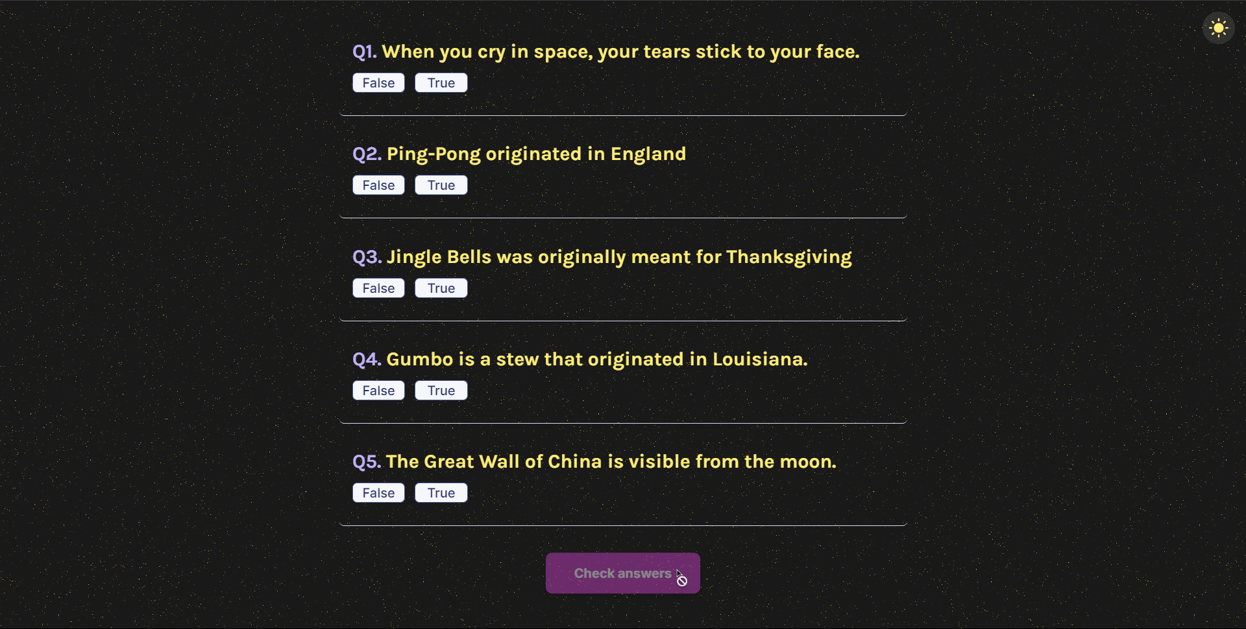
QUESTIONS PAGE - DARK MODE

Slide 17
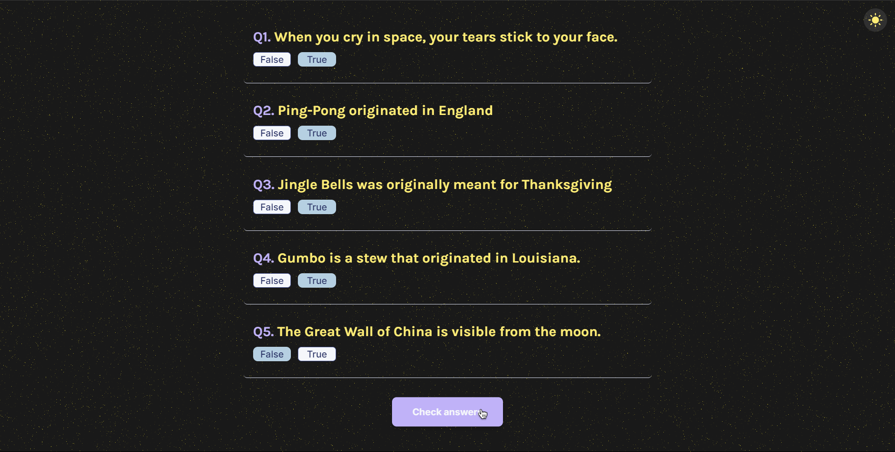
QUESTIONS PAGE - MARK ANSWERS

Slide 18
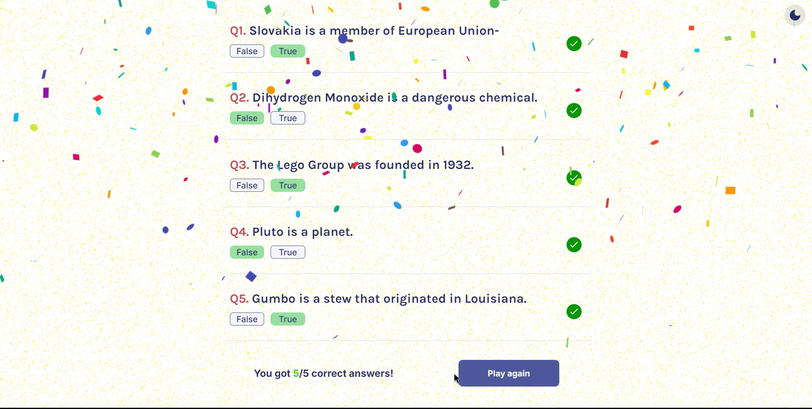
QUESTIONS PAGE - PERFECT

Slide 19
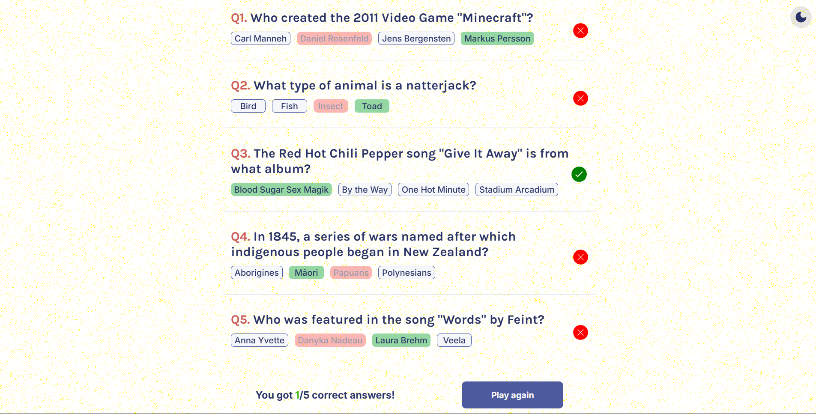
QUESTIONS PAGE - SCORE REVEAL

Slide 20
RESPONSIVENESS
To help improve the responsiveness of the website, we make use of media queries.
By doing this we are able to show the content in devices with varying screen sizes without any issue.
We are also able to change the layouts accordingly to different screen widths hence making sure that the website is accessible to everyone irrespective to screen size of their device
Next few slides shows the usage of this responsiveness in case for mobile devices and for tablets and larger screen sizes.

Slide 21
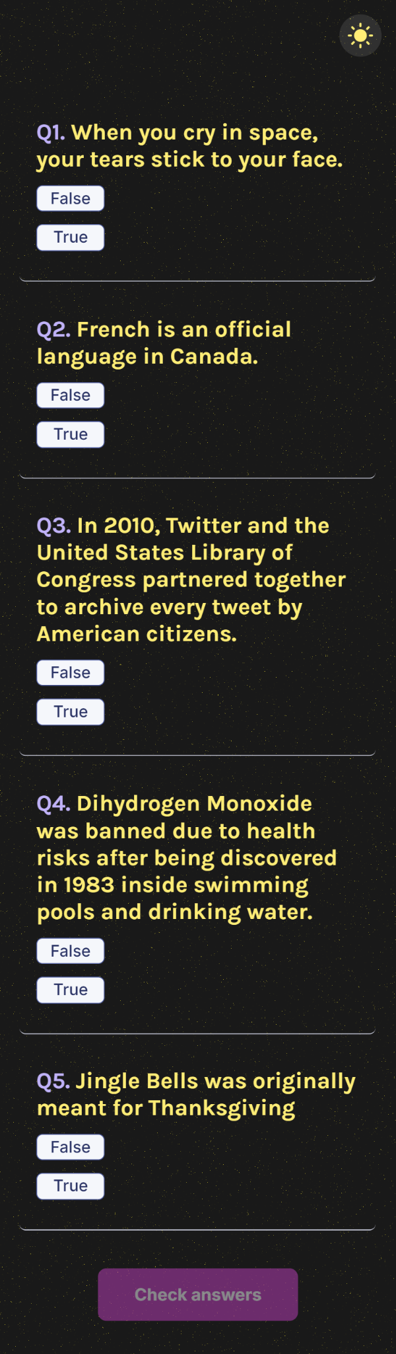
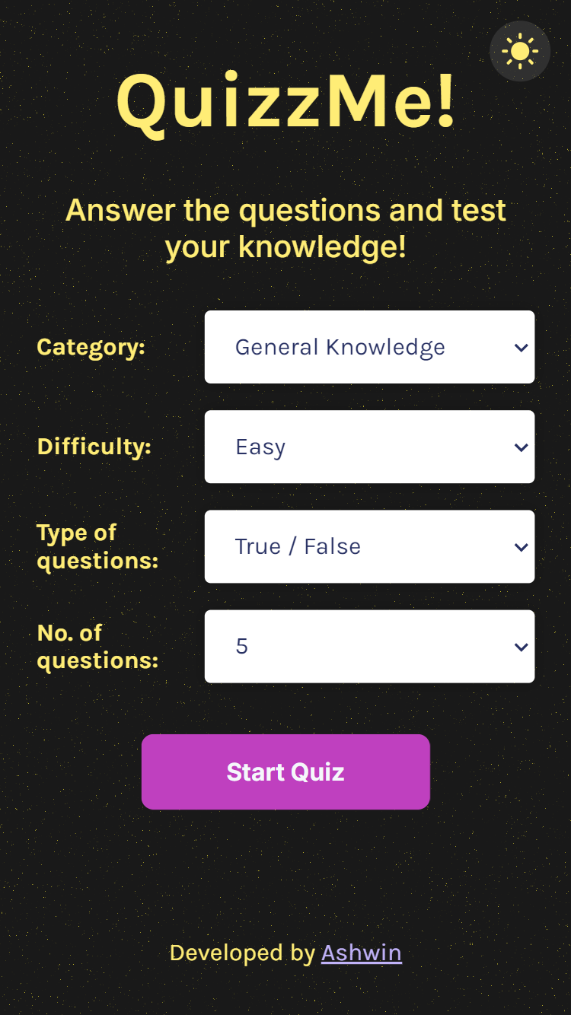
RESPONSIVENESS - 1

Slide 22
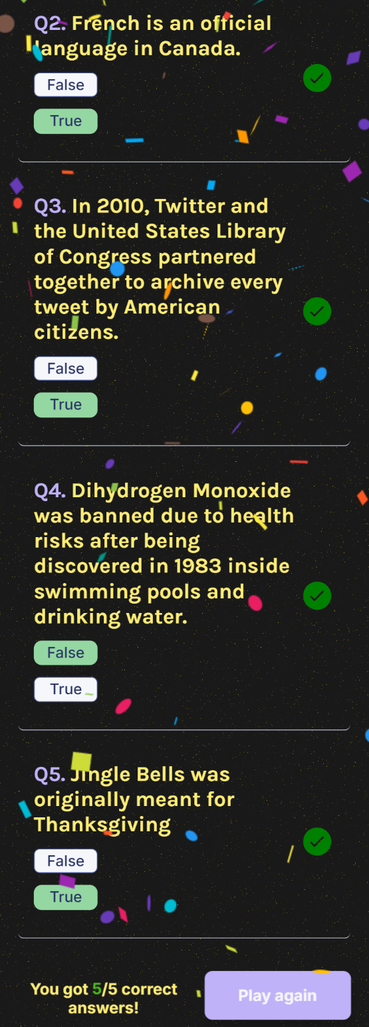
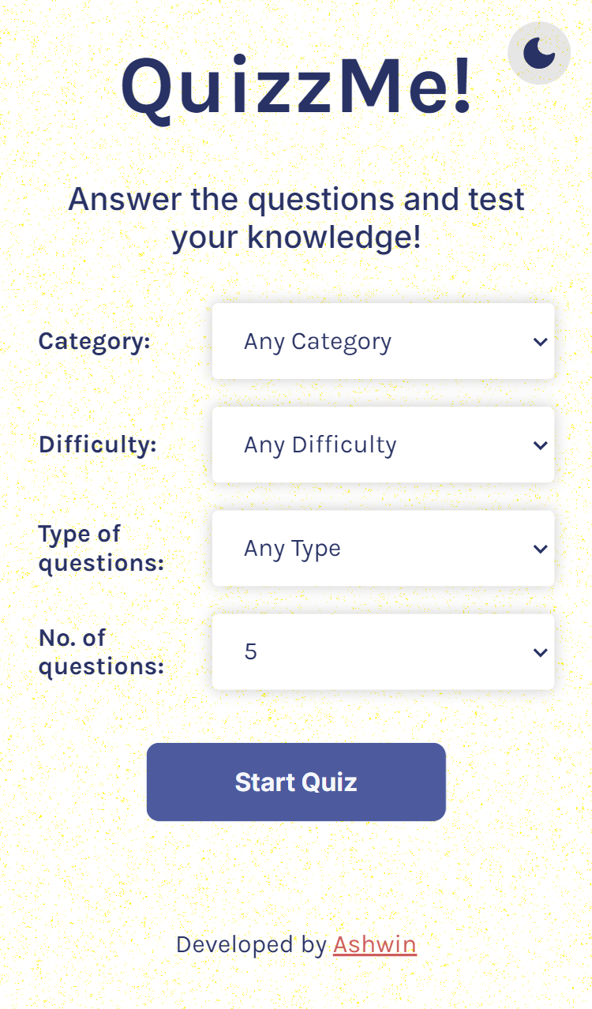
RESPONSIVENESS - 2

Slide 23
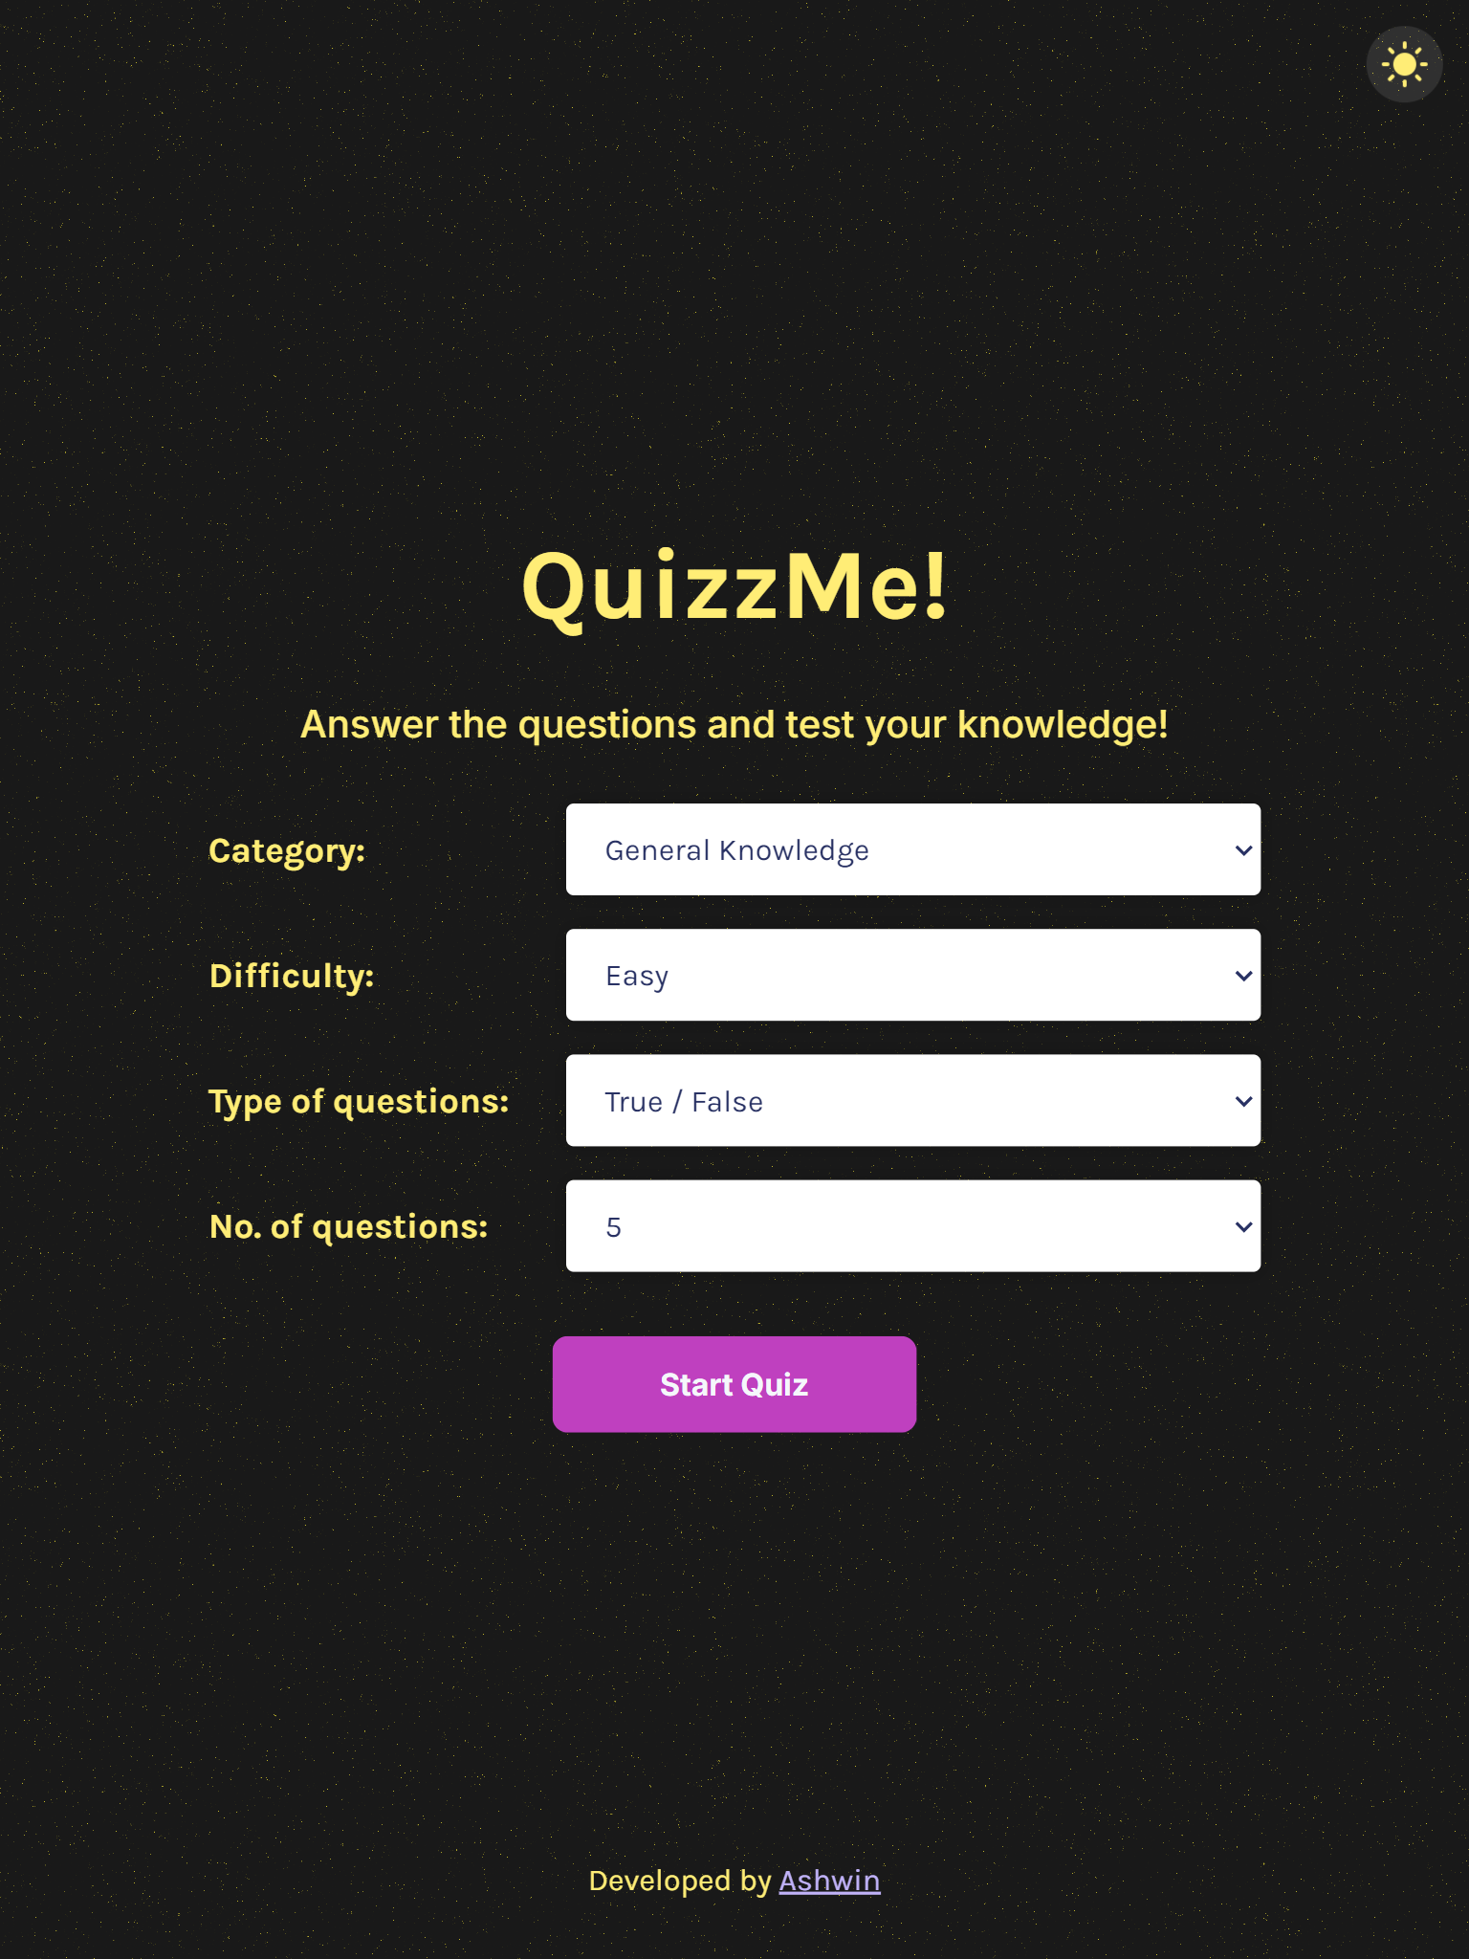
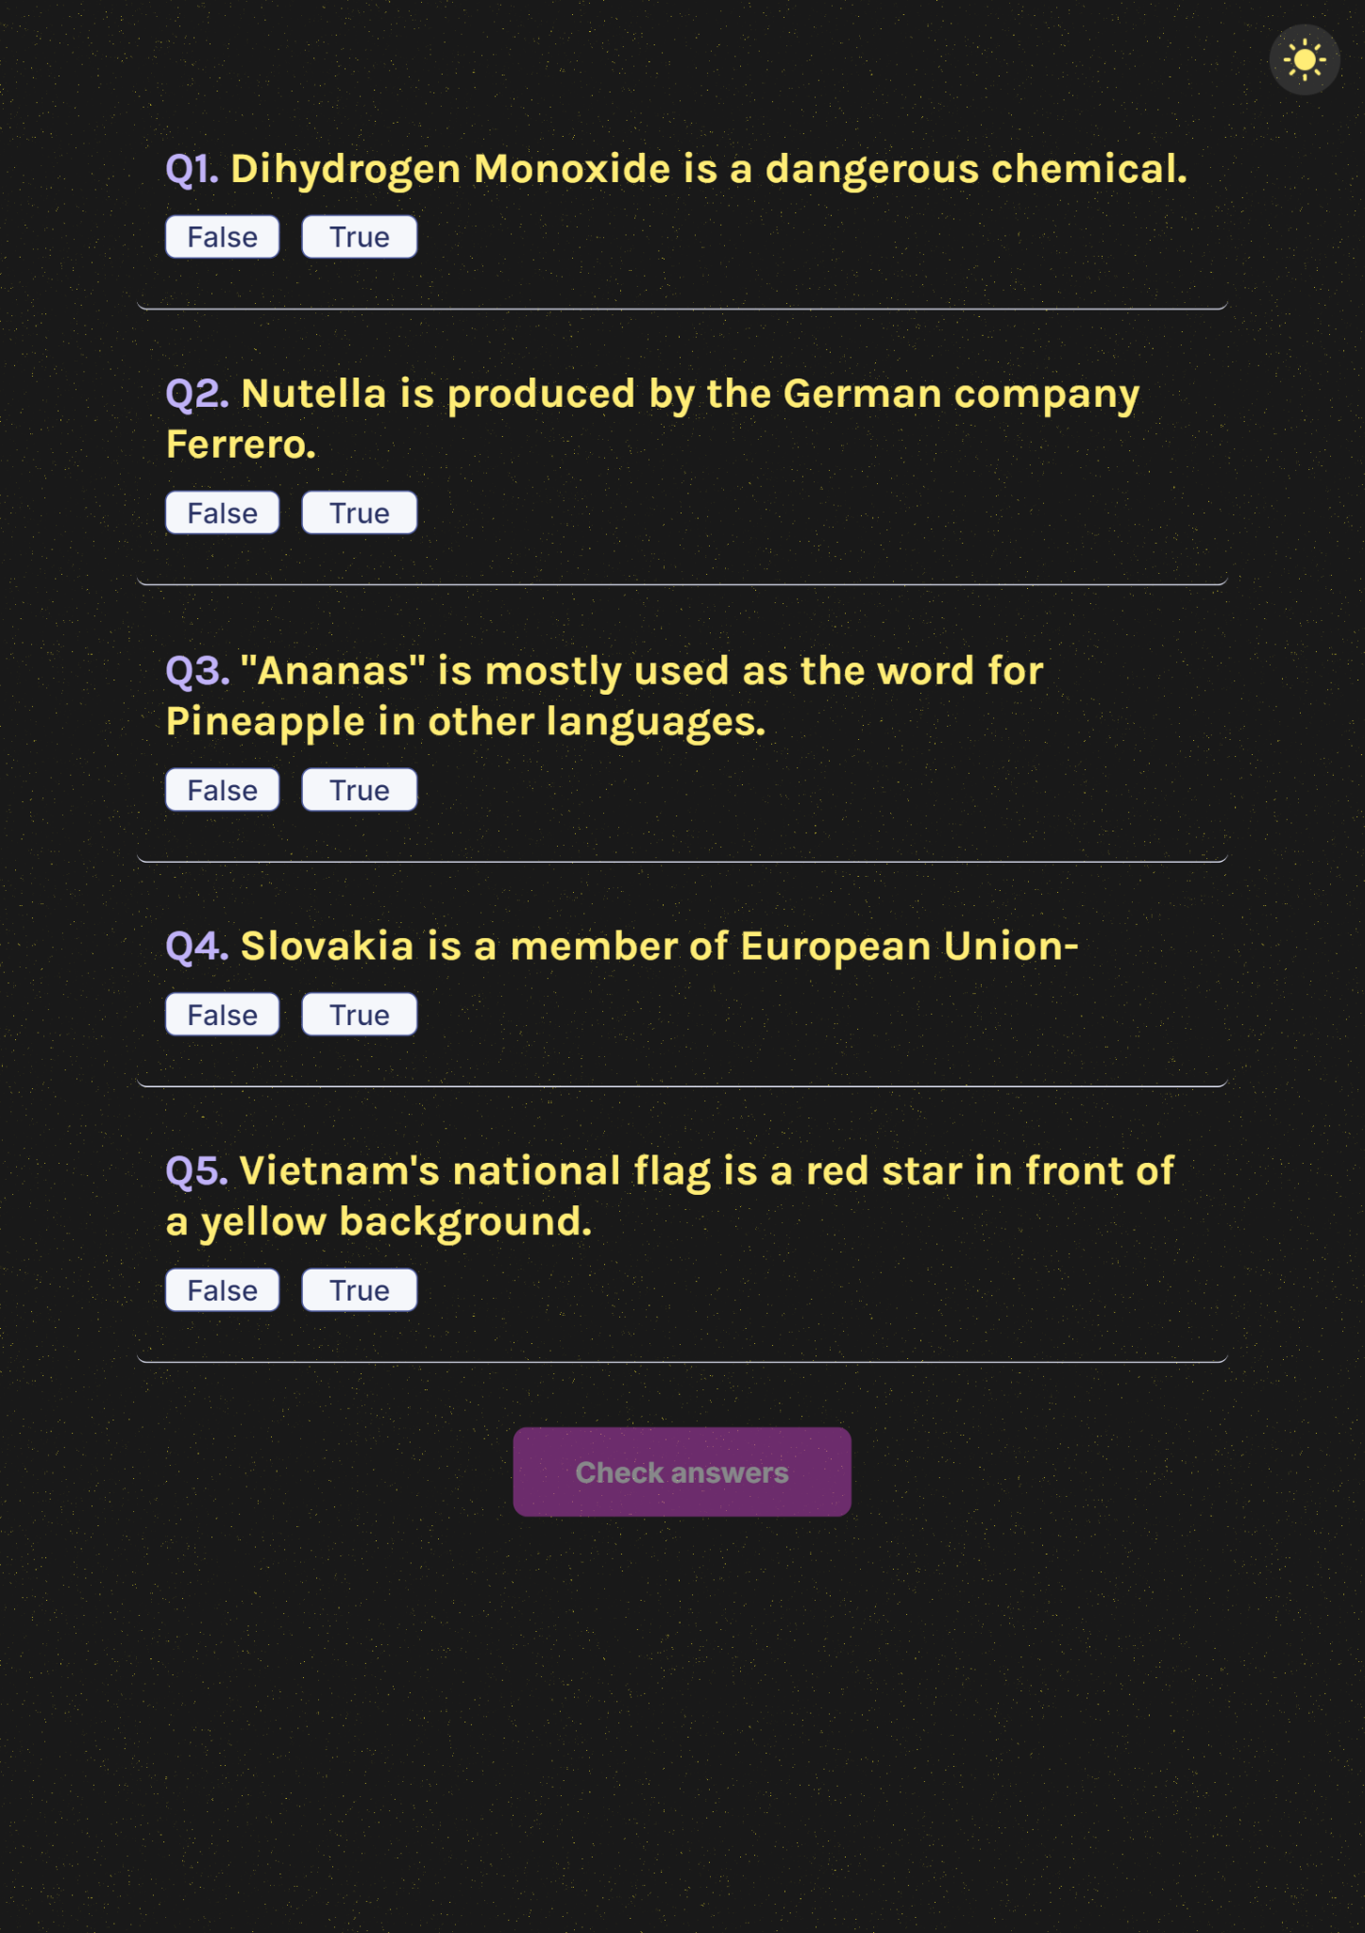
RESPONSIVENESS - 3

Slide 24
CONCLUSION
Engaging and Customizable Quiz Platform :
The website offers a dynamic quiz experience with options to select category, difficulty, and question type.
Real-Time Feedback and Scoring:
Users receive immediate feedback on their answers, with a final score displayed upon quiz completion.
Responsive and Interactive UI:
Built with React, the site ensures a smooth, interactive experience on various devices.
Fun Visual Elements:
Features like animated confetti celebrate users' perfect scores, enhancing engagement.
Easily Extensible Backend:
Designed to support further enhancements, such as user accounts, quiz history, and a wider range of question sources.
Scalable Design:
The project can be scaled to include new features, making it a strong foundation for further development in online education or entertainment applications.

Slide 25
THANK YOU!

